Slide 1








Group-based Fraud Detection Network on e-Commerce Platforms
Jianke Yu^{1,2}, Hanchen Wang^{1,3}, Xiaoyang Wang⁴, Zhao Li^{5,6}, Lu Qin³, Wenjie Zhang⁴, Jian Liao², Ying Zhang^{1,3}
¹ Zhejiang Gongshang University, ² Alibaba Group, ³ University of Technology Sydney, ⁴University of New South Wales, ⁵ Zhejiang University, ⁶ Hangzhou Link2Do Technology
KDD 2023

Slide 2
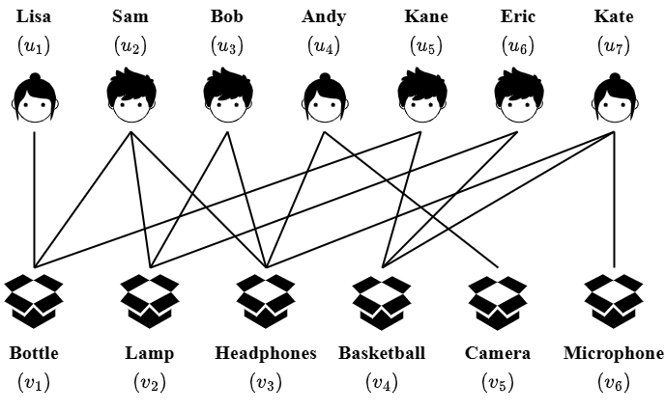
Background
Attributed Bipartite Graph
An attributed bipartite graph is a type of graph which consists of two sets of vertices that are linked by edges. Each of the vertices can have additional, making this graph particularly useful for representing information in the field of e-commerce.

Slide 3
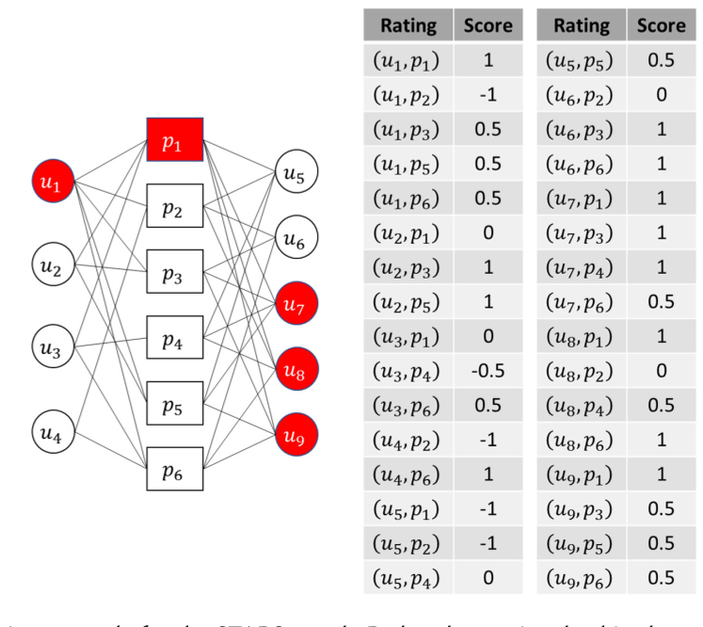
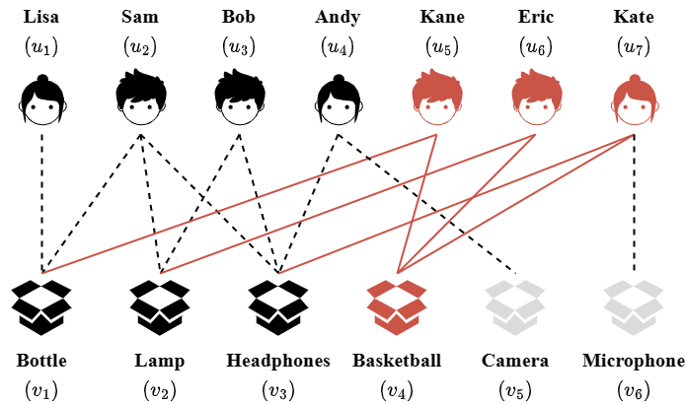
Background
Group-based Frauds on Attributed Bipartite Graphs
Group-based fraud is becoming increasingly rampant:
“Ride Item’s Coattails” attack (edge classification)
STARS attack (vertex classification)
Image source: STARS: Defending against Sockpuppet-Based Targeted Attacks on Reviewing Systems

Slide 4
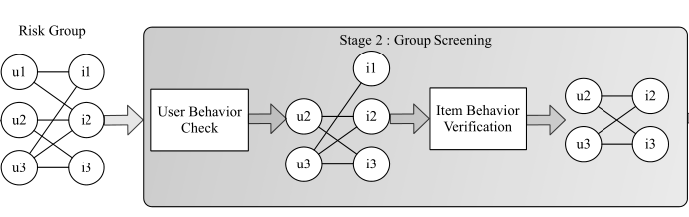
Background
SOTA method for “Ride Item’s Coattails” attack
RICD ((𝛼, 𝑘1, 𝑘2)-biclique): fraud detection method for “Ride Item’s Coattails” attack. Can only utilize structural information.
Tianchi competition winner’s algorithm: classification method. Can only use attribute information.
Image source: Large-scale Fake Click Detection for E-commerce Recommendation Systems

Slide 5
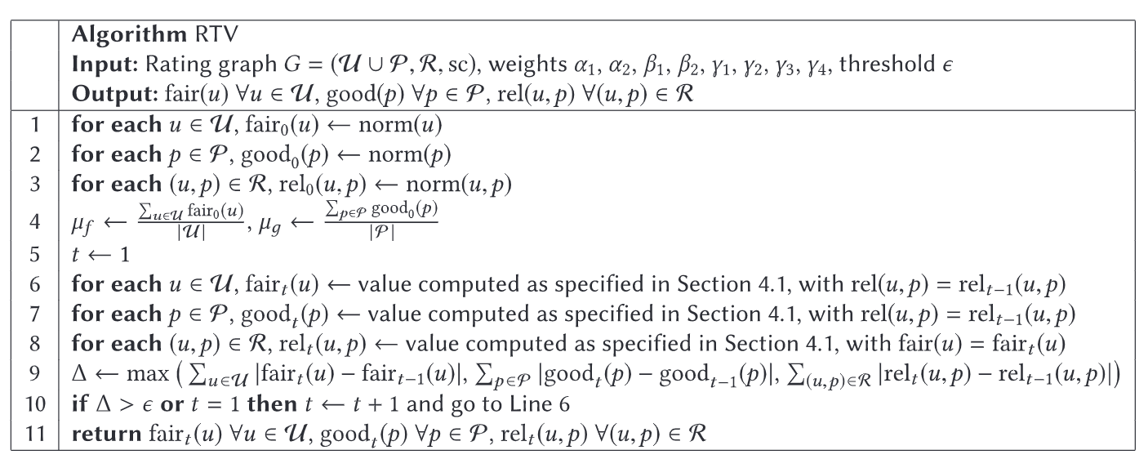
Background
SOTA method for STARS attack
RTV: fraud detection method for Sockpuppet-based Targeted Attack on Reviewing Systems (STARS). Unable to make good use of label information.
Image source: STARS: Defending against Sockpuppet-Based Targeted Attacks on Reviewing Systems

Slide 6
Background
Existing methods
Classification Methods:
Imbalanced labeled vertices, community information.
Cohesive Subgraph Mining Methods:
Attribute and label information, suffer from NP-completeness.
Fraud Detection Methods:
Global topological and attribute information, label information, manual parameter setting.

Slide 7
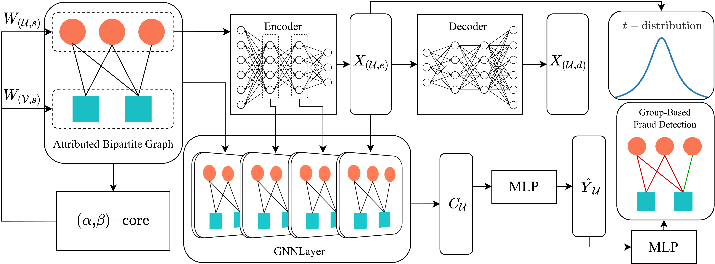
Overview
Group-based Fraud Detection method: GFDN

Slide 8
Overview
Group-based Fraud Detection method: GFDN

Slide 9
Overview
Group-based Fraud Detection method: GFDN

Slide 10
Overview
Group-based Fraud Detection method: GFDN

Slide 11
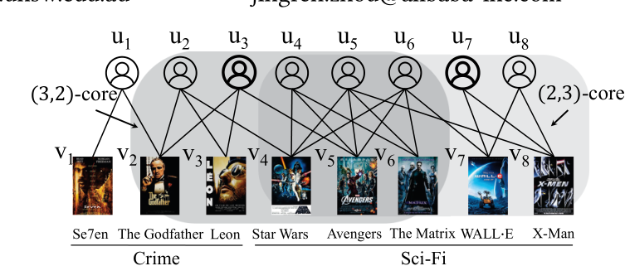
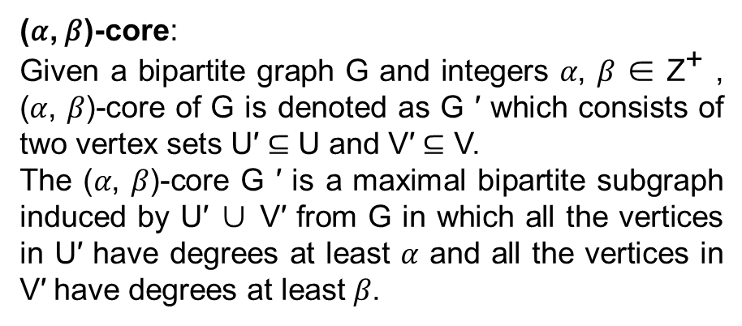
GFDN
Structural Feature Initialization
(𝛼, 𝛽)-core:
Given a bipartite graph G and integers 𝛼, 𝛽 ∈ ${\text{Z}}^{\text{+}}$ , (𝛼, 𝛽)-core of G is denoted as G ′ which consists of two vertex sets U′ ⊆ U and V′ ⊆ V.
The (𝛼, 𝛽)-core G ′ is a maximal bipartite subgraph induced by U′ ∪ V′ from G in which all the vertices in U′ have degrees at least 𝛼 and all the vertices in V′ have degrees at least 𝛽.
Image source: Efficient (α, β)-core Computation: an Index-based Approach

Slide 12
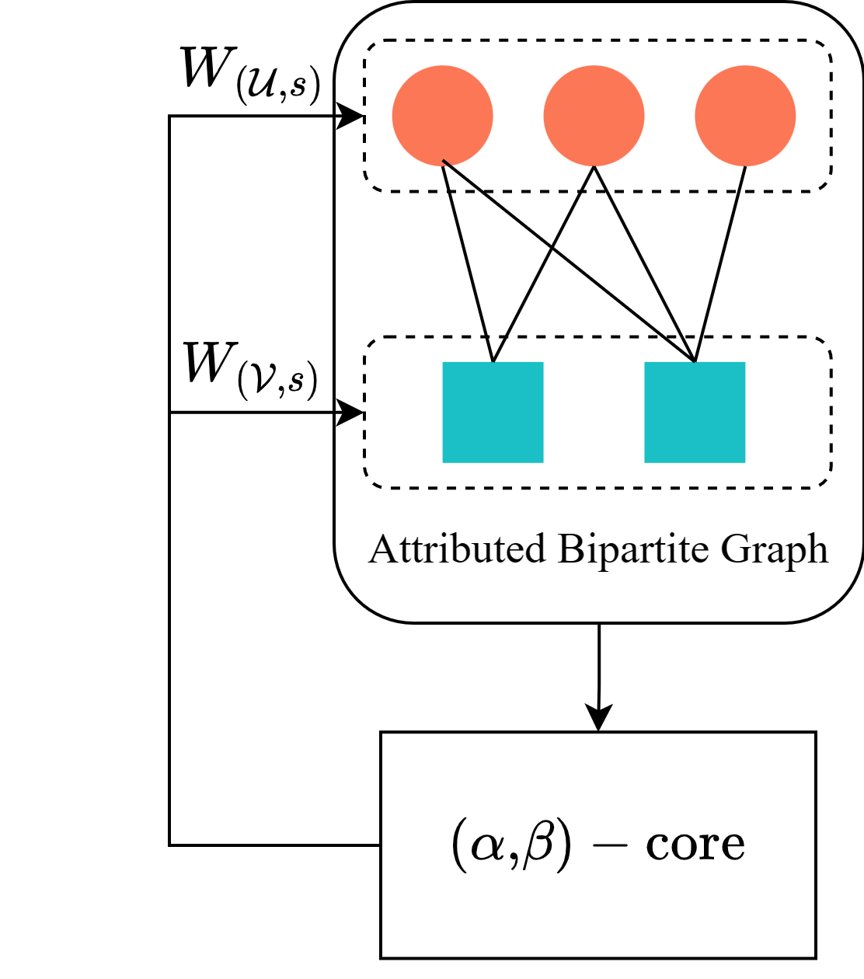
GFDN
Structural Feature Initialization
GFDN will generate structural features for vertices based on their existence in different (𝛼, 𝛽)-core.
Structural Features
Element-wise Product
All-ones Vector
Weight Matrix

Slide 13
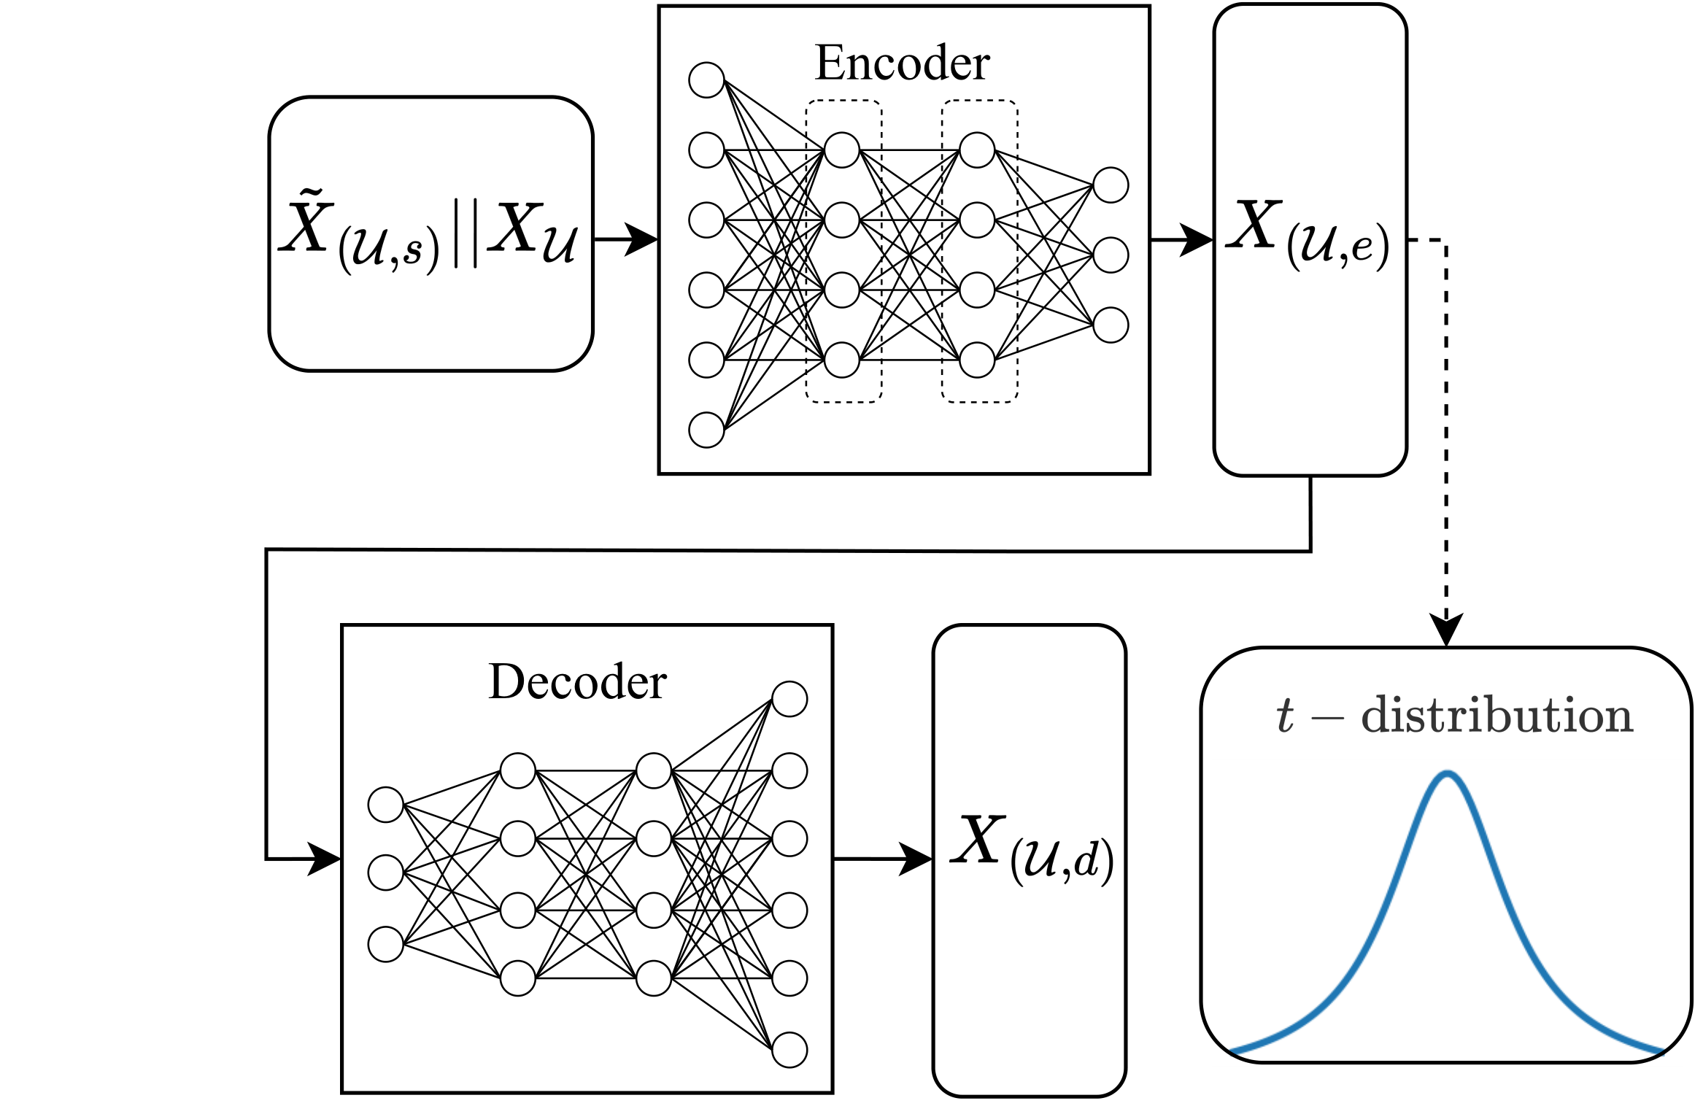
GFDN
Fraudster Community Detection
BDCN - Autoencoder:
Autoencoder in Bipartite Deep Clustering Network (BDCN) can:
1. preserving both structural and attribute information from the input features.
2. Generate high-quality community representation for customer vertices.
It can achieve self-supervised fraud community detection using a loss function measures with Student's t-distribution kernel.

Slide 14
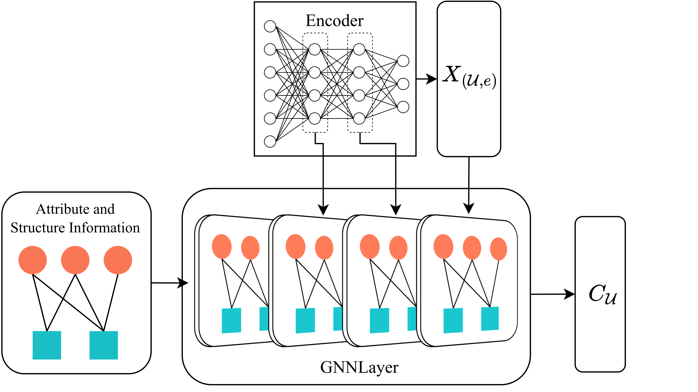
GFDN
Fraudster Community Detection
BDCN - GNN:
GNN in BDCN can aggregate on attribute bipartite graph and preserve the attribute information and structural information of the graph well. The output of encoding layer will be used.

Slide 15
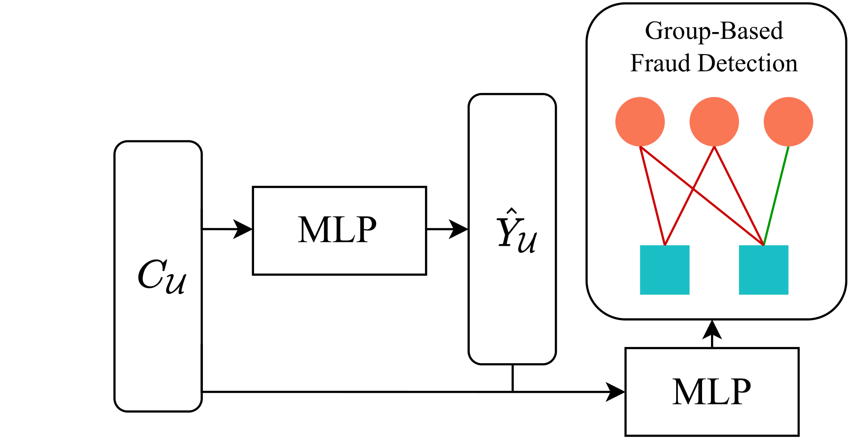
GFDN
Training Objective
"Ride Item’s Coattails" Attack:
In "Ride Item’s Coattails" attack, not all edges related to fraudsters necessarily have attack implications. GFDN will perform multi-task training on this issue, predicting both fraudsters and fraudulent attack.
STARS Attack:
STARS attack detection aims to detect fraudsters, in which case GFDN only needs to perform the vertex classification task.

Slide 16
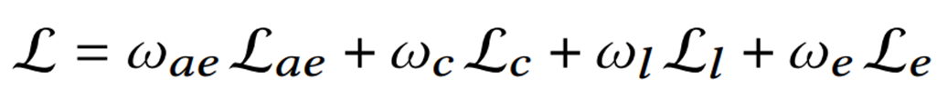
GFDN
Training Objective
The final loss function will be composed of the loss functions of the aforementioned modules, including autoencoder, community prediction, fraudster prediction, and fraudulent prediction. The sum of the weights of all parts of them is 1.
Autoencoder
Community
Fraudster
Fraudulent

Slide 17
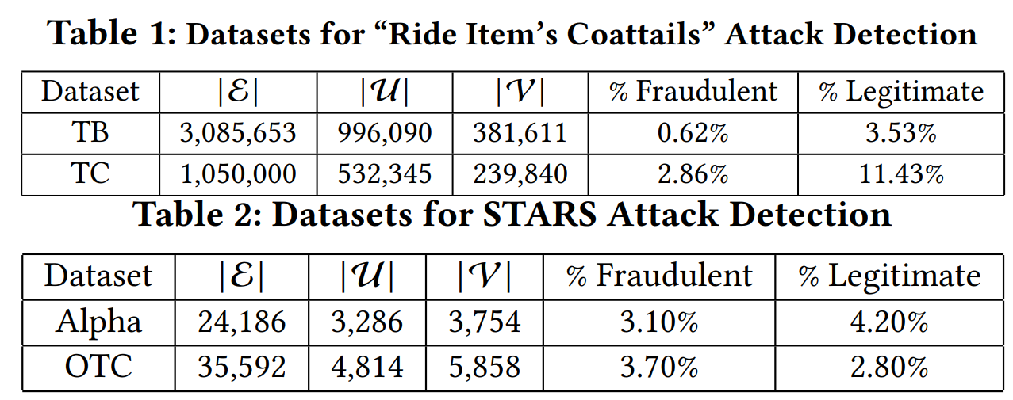
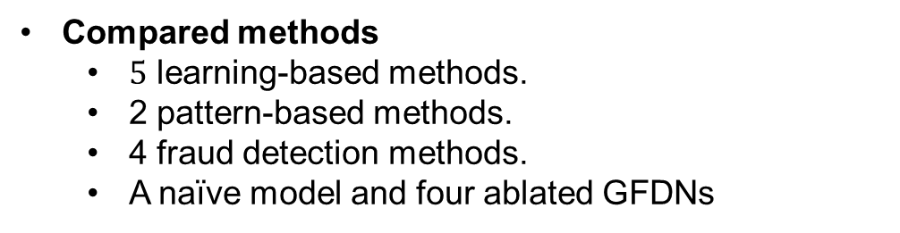
Experiments
Experimental Setup
Dataset
4 real-life datasets.
Compared methods
$5$ learning-based methods.
2 pattern-based methods.
4 fraud detection methods.
A naïve model and four ablated GFDNs
Parameter settings
The number of GNN layer: 4.
The number of community: 32.
Hidden dimension: 128.
The selected GNN is GraphSAGE.
Implementation
Structure information extraction: C++
Other Parts of the Model :Python + Pytorch Geometric.

Slide 18
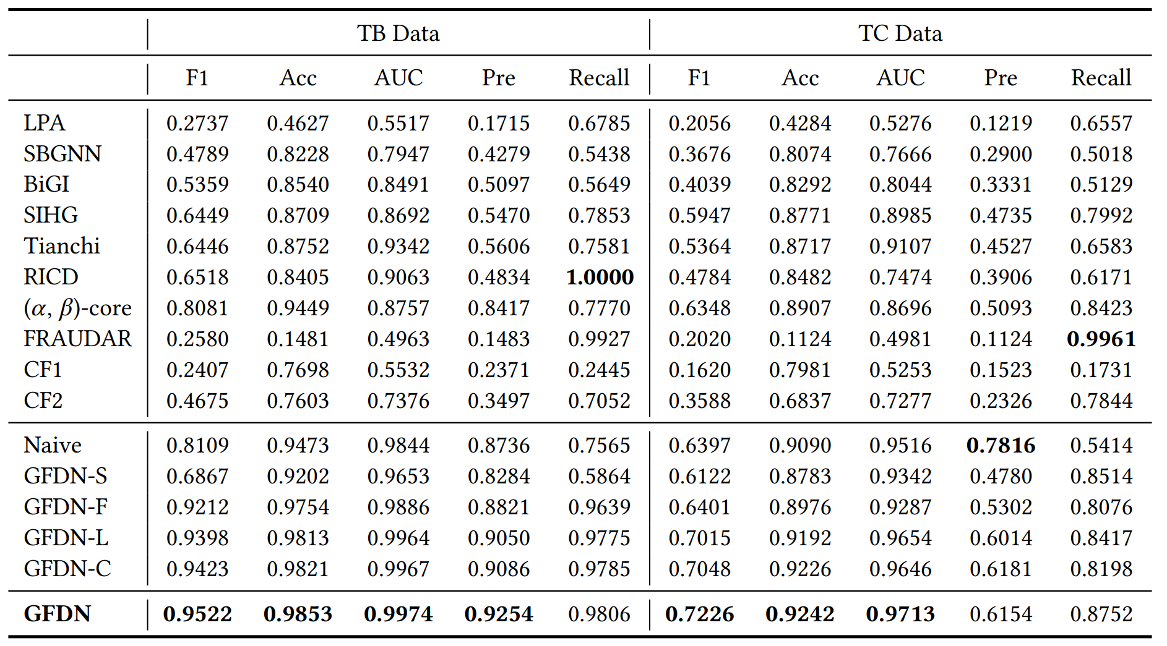
Experiments
Effectiveness Evaluation Results for “Ride Item’s Coattails” Detection

Slide 19
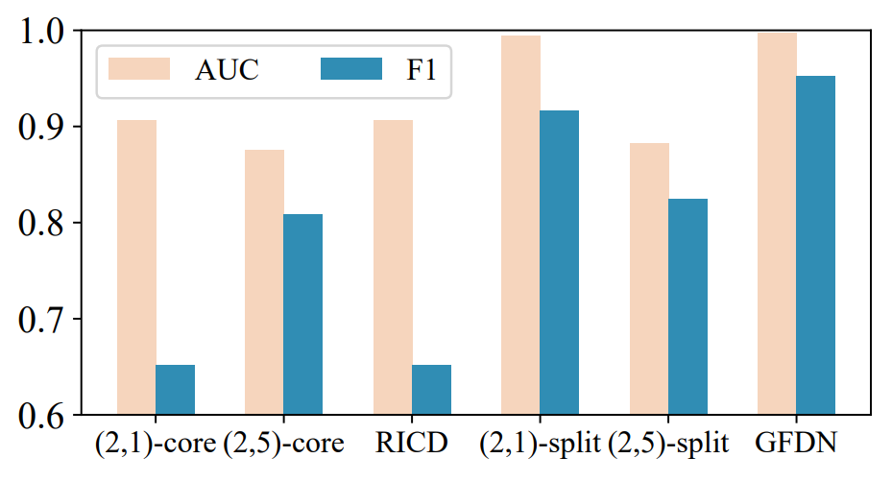
Experiments
Comparison with Pattern-based Algorithms

Slide 20
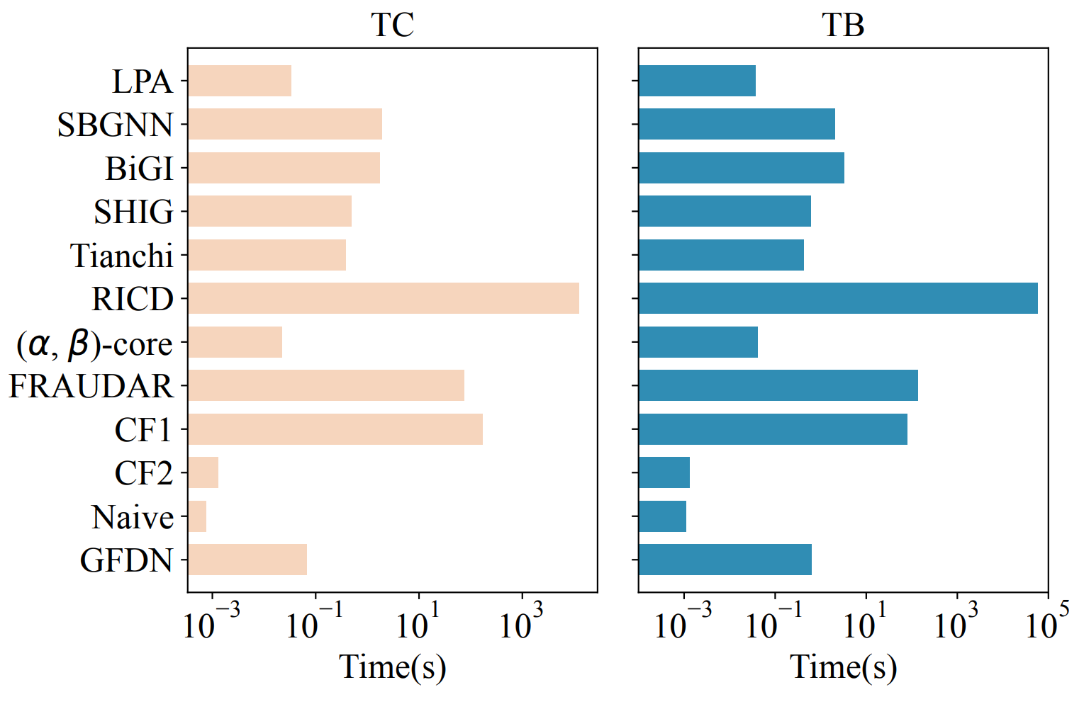
Experiments
Query Time Evaluation of “Ride Item’s Coattails” Detection

Slide 21
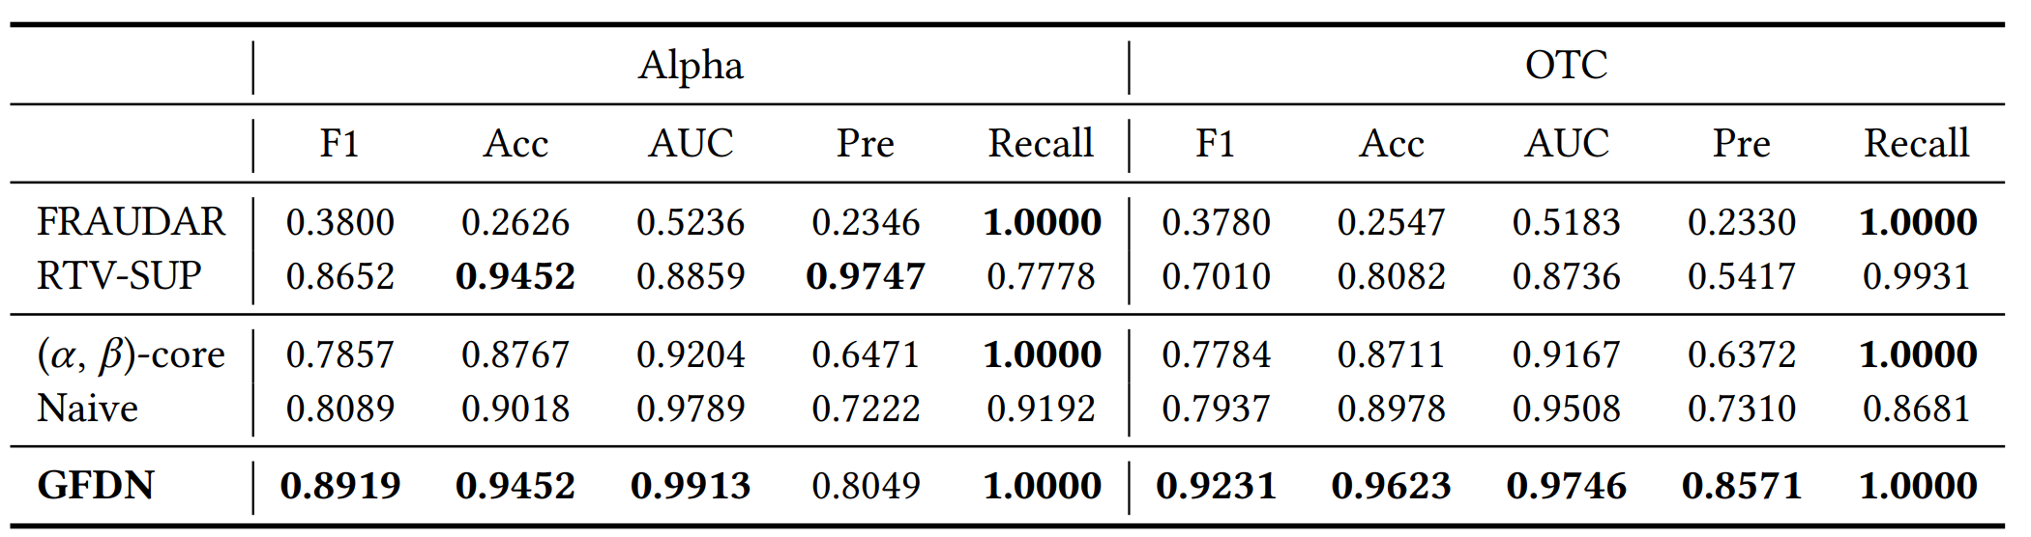
Experiments
Effectiveness Evaluation Results for STARS Detection

Slide 22
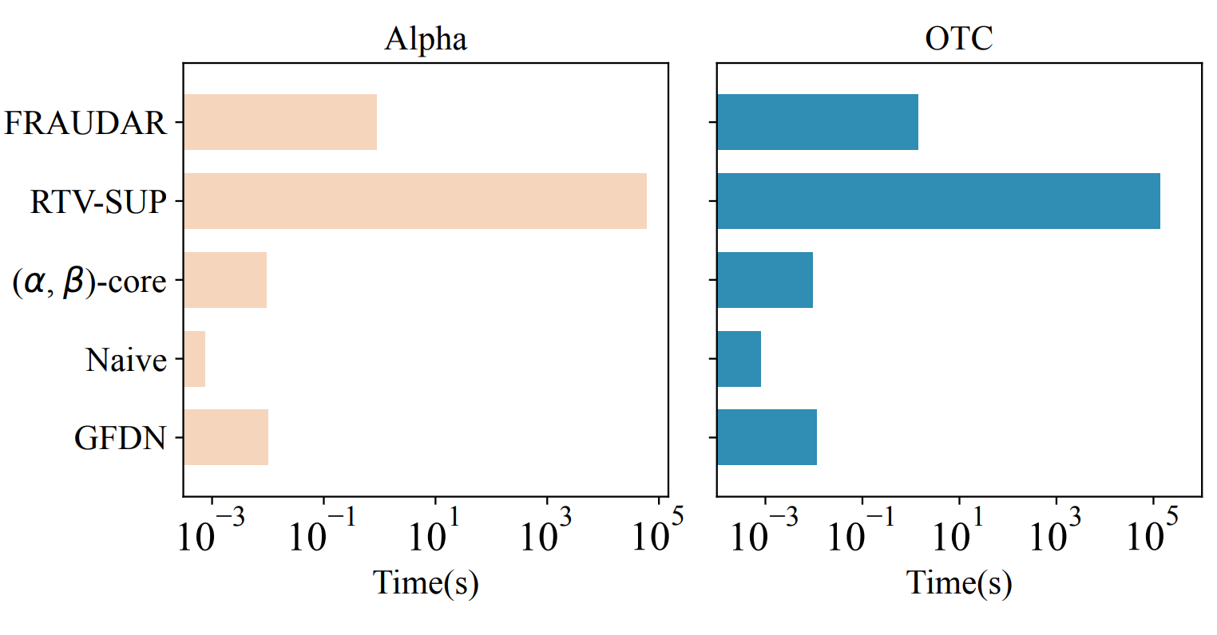
Experiments
Effectiveness Evaluation Results for STARS Detection

Slide 23
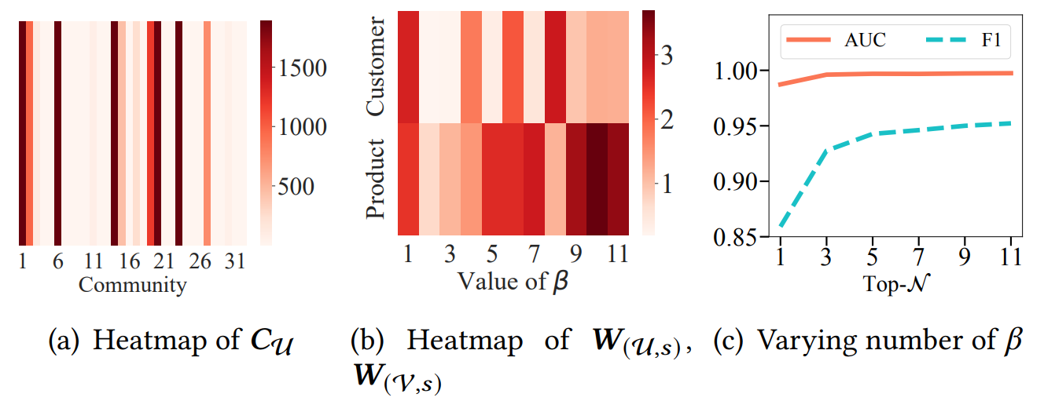
Experiments
In-Depth Effectiveness Analysis of GFDN

Slide 24
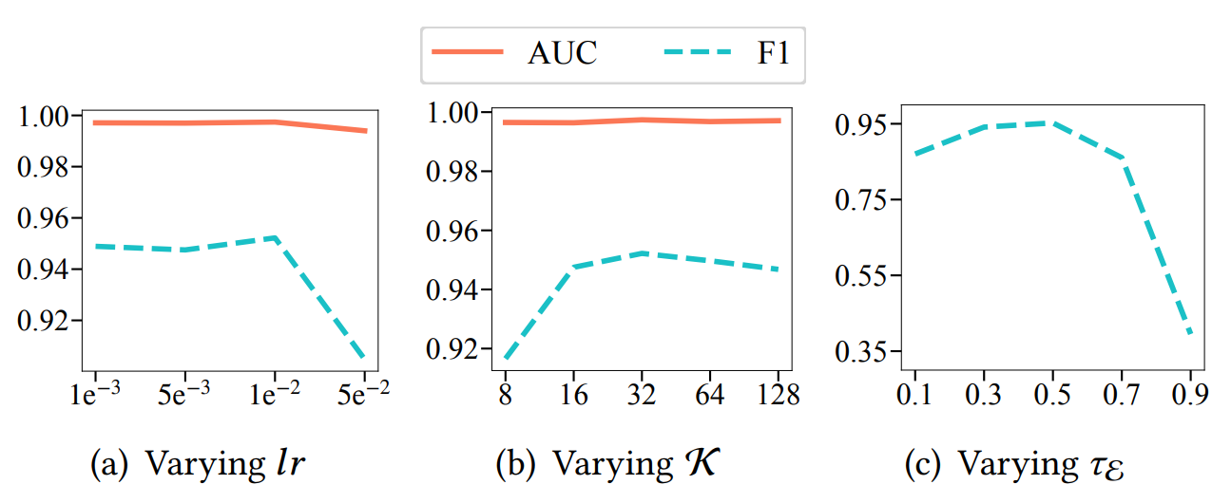
Experiments
Parameter Analysis Results in GFDN

Slide 25
Thank you!
Jianke Yu, Zhejiang Gongshang University.
jiankey.zjgsu@gmail.com

